Slide 1
Game Programming Expectations

Slide 2


Slide 3


Slide 4



Slide 5
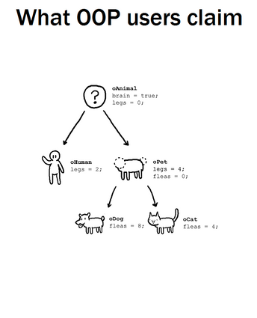

Slide 6
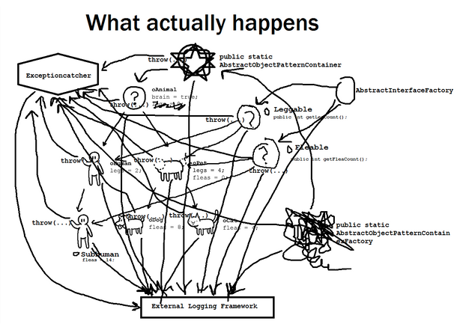

Slide 7
Object-Oriented Design Can Cause Headaches

Slide 8
Reasons Why

Slide 9


Reasons Why
Doesn’t Scale

Slide 10
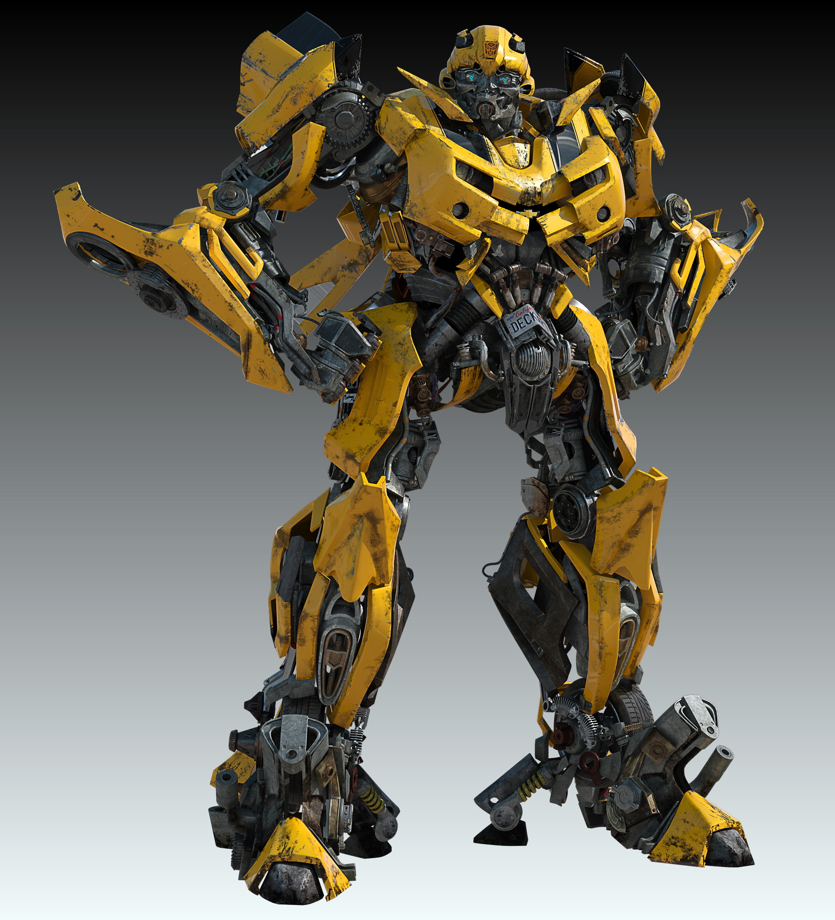

Reasons Why
Doesn’t Scale
Anti-Modular

Slide 11
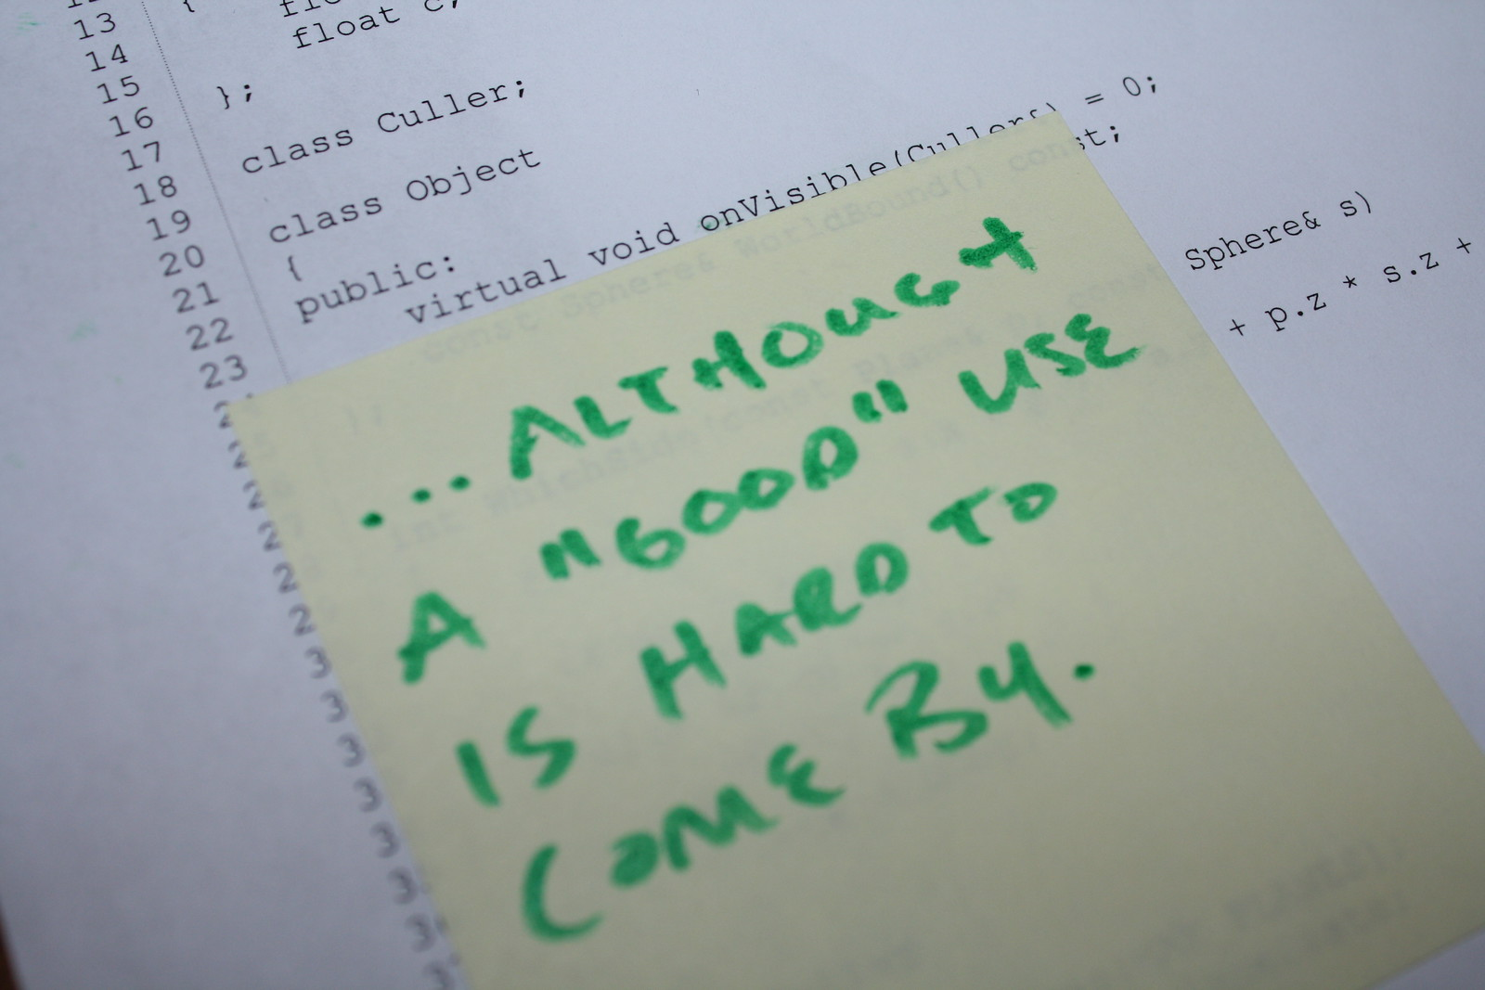
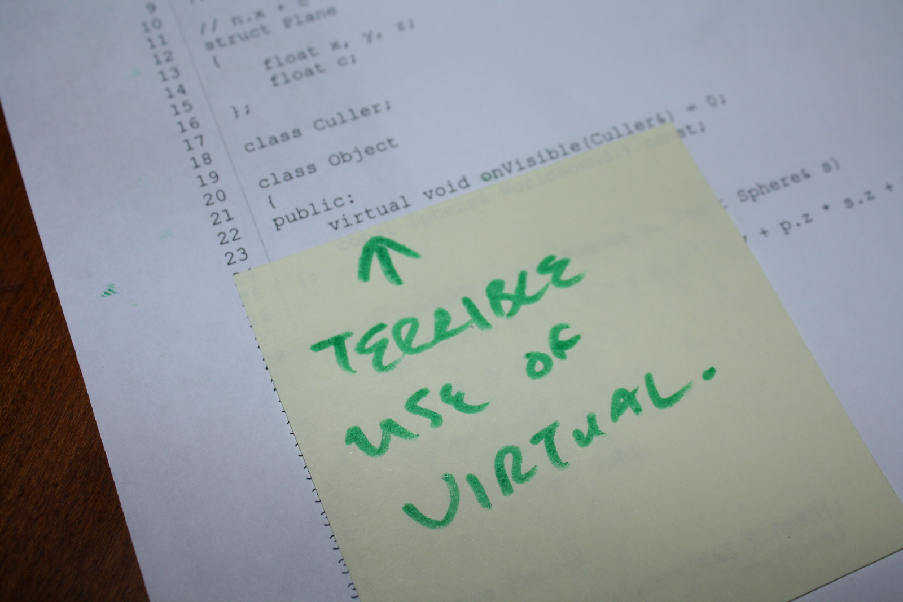
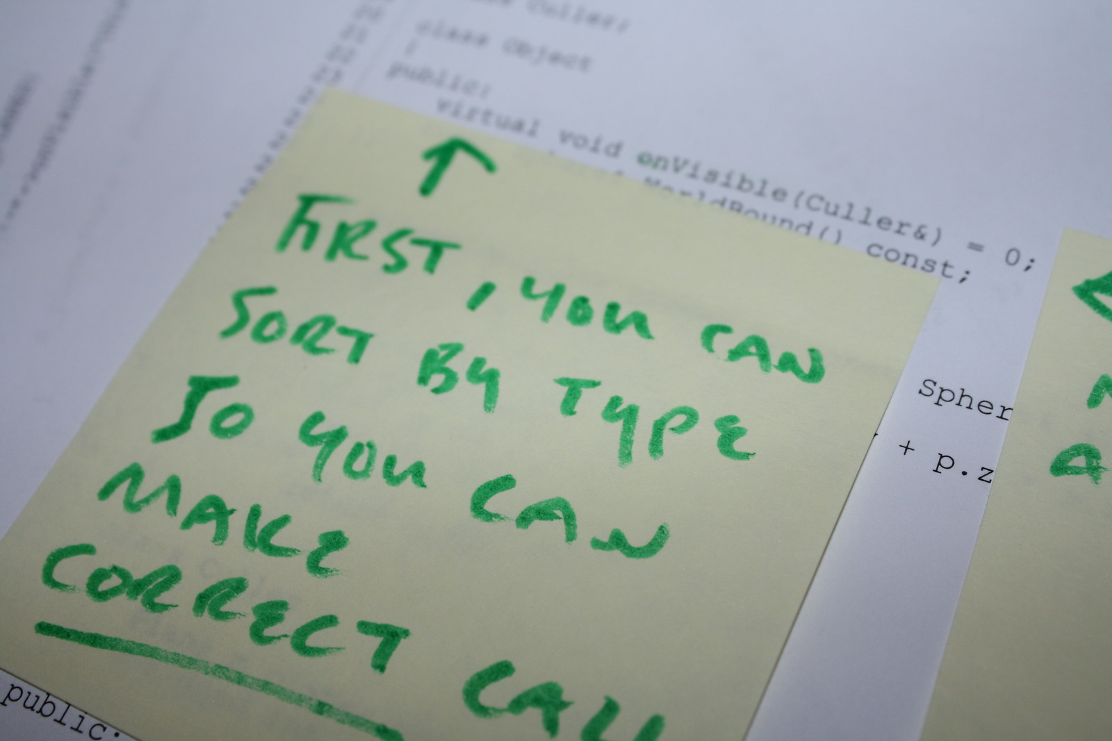
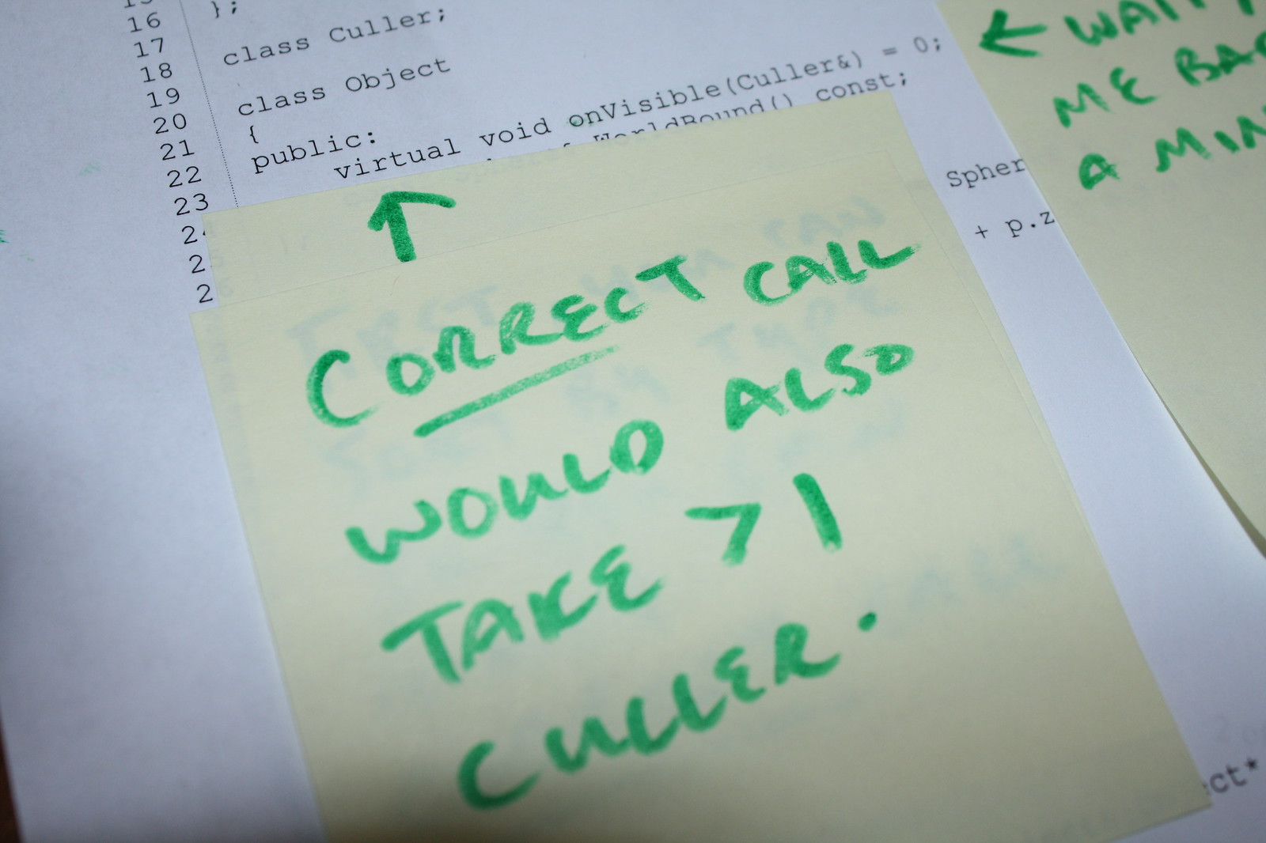

Reasons Why
Doesn’t Scale
Anti-Modular
Anti-Parallel

Slide 12
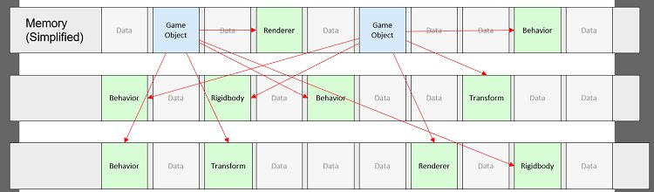
Reasons Why
Doesn’t Scale
Anti-Modular
Anti-Parallel
Cache Misses

Slide 13
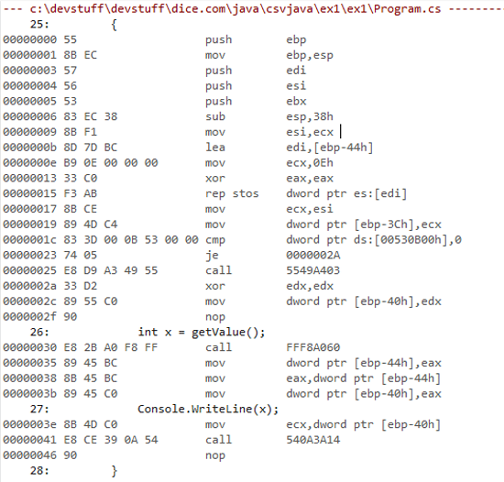
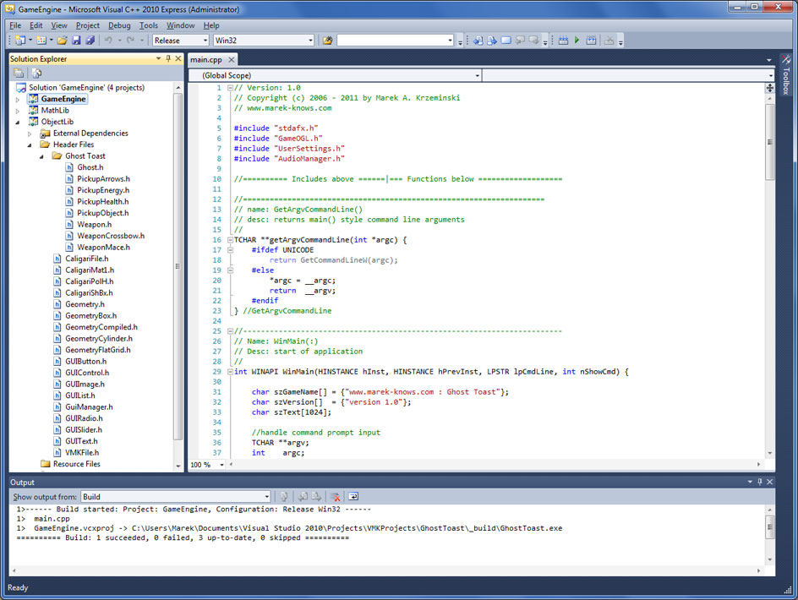

Reasons Why
Doesn’t Scale
Anti-Modular
Anti-Parallel
Cache Misses
Abstraction

Slide 14

Data-Oriented Design Solves These Problems!

Slide 15


It’s All About The Data

Slide 16
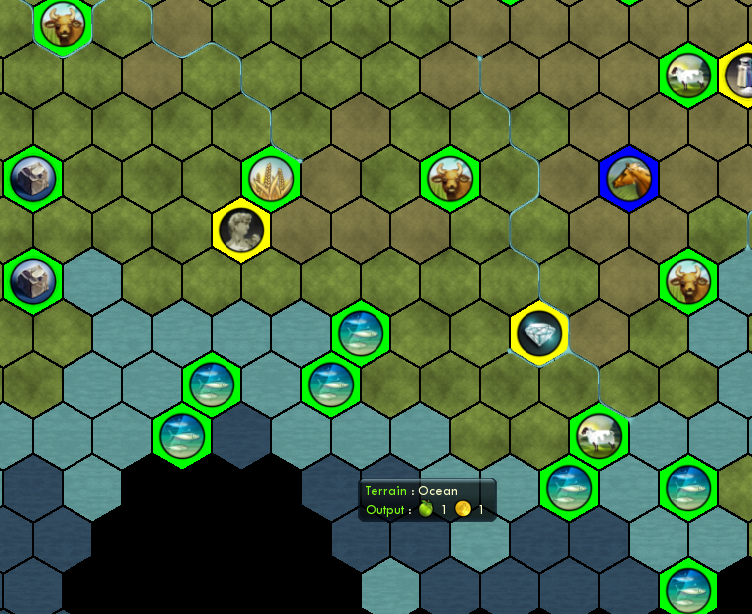
Data Is Not The Problem Domain

Slide 17
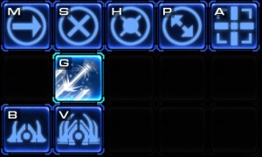
Data is the type, frequency, quantity, shape and probability

Slide 18


Data Can Change

Slide 19
